Slide 1
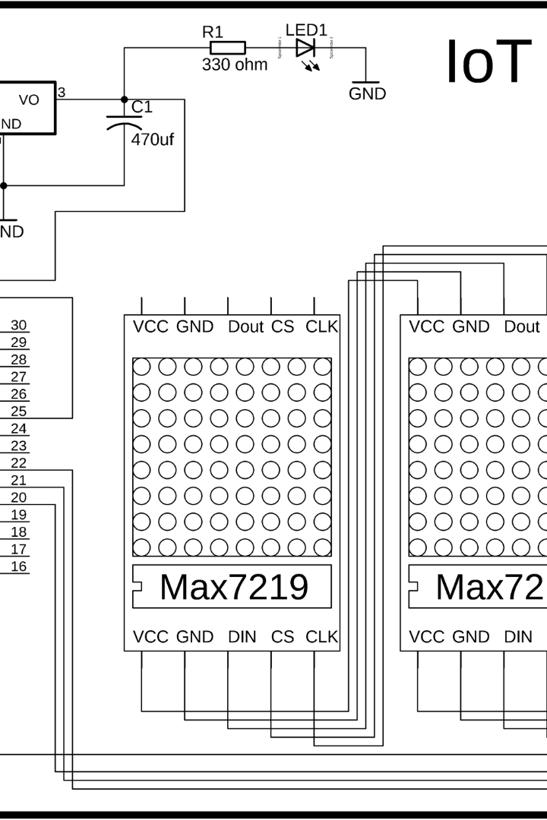
Smart LED Notice Board with Wifi Module
Learn all about the exciting technology of a smart LED notice board with wifi module and how it can revolutionize your daily operations.
Team mates:
L.Chetan harsha-21030
Ch.Chandra shekhar-21011
Barath-21009
K.Gnaneswar-21029

Slide 2

Key Features
1
Remote management
2
Multiple display options
Efficiently manage and schedule your messages without having to be in the same place as the notice board.
Make your messages stand out with varying font and display options.
3
Real-time updates
4
Customizable design
Keep your messages current and up-to-date with automatic updates through WiFi module.
Design your notice board to match your brand and message in just a few clicks.

Slide 3
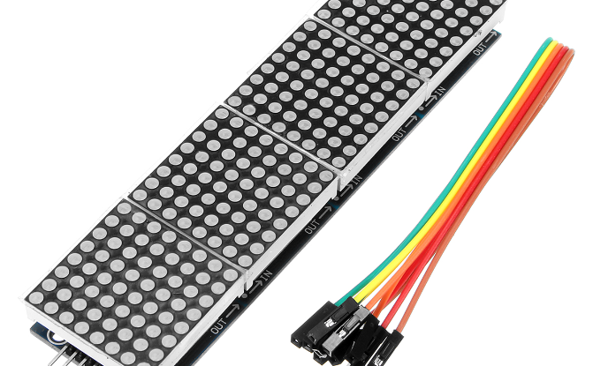
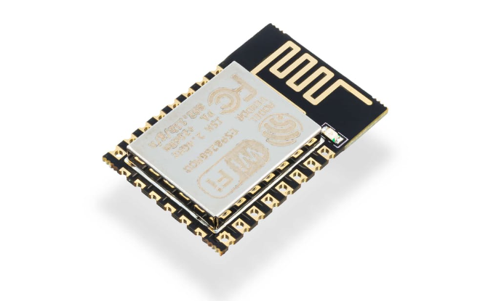
Hardware Components
LED Display Screen
WiFi Module
Provides bright, high-quality images even in daylight.
Enables easy updates and content management from anywhere.

Slide 4
Software Components
Content management software
Media library
Provides simple and user-friendly interface for updating and editing content in real-time.
Access a wide range of media such as images, videos, and PDFs that can be easily integrated into your messages.
Scheduling app
Customizable templates
Set up schedules in advance that automatically display your messages at specific times or days.
Choose from different pre-made templates or easily design your own to match your message.

Slide 5
Applications
Education
Retail
Corporate
Improve communication and information sharing between students, staff, and administration. Can be used to display class schedules, daily events, and daily messages.
Provide customers with up-to-date product information, pricing, branding messages, and even entertainment while waiting in queues.
Use for internal communication among employees, creating a sense of unity, and strengthening teamwork.

Slide 6

Code
#include <ESP8266WiFi.h>
#include <MD_Parola.h>
#include <MD_MAX72xx.h>
#include <SPI.h>
#define DEBUG 0
#if DEBUG #define PRINT(s, x) {
Serial.print(F(s));
Serial.print(x); }
#else
#define PRINT(s, x)
#endif
MD_Parola P = MD_Parola(MD_MAX72XX::FC16_HW, 15, 8);
const char* ssid = "";
const char password = "*";
WiFiServer server(80);
uint8_t frameDelay = 25;
textEffect_t scrollEffect = PA_SCROLL_LEFT;
char curMessage[512], newMessage[512];
bool newMessageAvailable = false;
const char WebResponse[] = "HTTP/1.1 200 OK\nContent-Type: text/html\n\n"; const char WebPage[] = "..."; // Your HTML here
uint8_t htoi(char c)
{
c = toupper(c);
return (c >= '0' && c <= '9') ? (c - '0') : (c - 'A' + 0xa); }
void getData(char *szMesg)
{ // ... Your existing code for extracting data }
void handleWiFi()
{ // ... Your existing code for handling WiFi requests }
void setup()
{ Serial.begin(57600);
P.begin(); P.setIntensity(0);
P.displayClear();
P.displaySuspend(false);
P.displayScroll(curMessage, PA_LEFT, scrollEffect, frameDelay); curMessage[0] = newMessage[0] = '\0';
WiFi.begin(ssid, password);
while (WiFi.status() != WL_CONNECTED)
{
delay(500);
}
server.begin();
sprintf(curMessage, "%03d:%03d:%03d:%03d", WiFi.localIP()[0], WiFi.localIP()[1], WiFi.localIP()[2], WiFi.localIP()[3]);
}
void loop()
{ handleWiFi();
if (P.displayAnimate())
{
if (newMessageAvailable) { strcpy(curMessage, newMessage); newMessageAvailable = false; } P.displayReset();
} }

Slide 7

Future Developments
1
Mobile control
2
Artificial intelligence integration
3
Cloud computing
Develop a mobile app that allows for easy content management from virtually anywhere.
Introduce cloud computing technology that enables the notice board to automatically sync with your content management library.
Implement AI technology to deliver personalized, real-time messages to intended audiences.

Slide 8

Conclusion
A smart LED notice board with WiFi module offers a sleek and modern solution that increases efficiency, improves communication, and helps businesses and schools stay organized. From retail to education to corporate environments, this technology has endless applications and evolving possibilities to fit your specific needs.

